Slide 1
INVENTORY
MANAGEMENT
-PREPARED BY:
RUSHIL D MEHTA 160410116060
S.Y.IT-1

Slide 2
INTRODUCTION
Inventory is material that the firm obtains in advance of need, holds until it is needed, and then used, consumed or incorporates into a product. A business inventory is temporary in nature.
Inventories are stock of any kind like fuel and lubricants, spare parts and semi-processed materials to be stored for future use mainly in the process of production or it can be known as the ideal resource of any kind having some economic values.

Slide 3
INVENTORY VALUATION INVOLVES TWO PROCESS
Determination of quality of each type of inventory held.
Assignment of the values of the units items of inventory

Slide 4
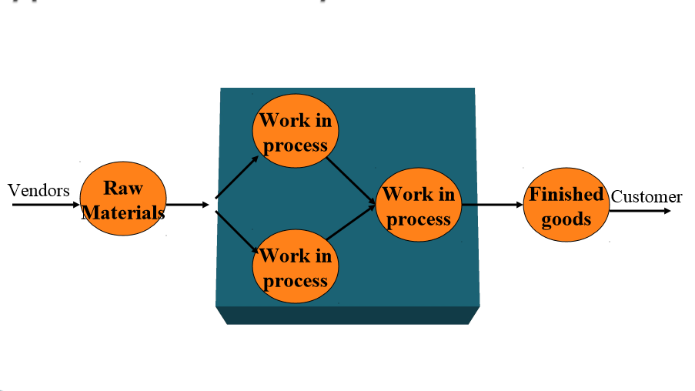
TYPES OF INVENTORY

Slide 5
NATURE OF INVENTORY
Raw Materials – Basic inputs that are converted into finished product through the manufacturing process.
Work-in-progress – Semi-manufactured products need some more works before they become finished goods for sale.
Finished Goods – Completely manufactured products ready for sale.

Slide 6
INVENTORY CONTROL
Inventory control is the means by which materials of the correct quality and in correct quantity are made available as and when required with due regard to storage and ordering cost. Here the desired level of inventory can neither be high or low because high level inventory will lead to increase in carrying cost while low level of inventory will lead to increase in ordering cost

Slide 7
OBJECTIVES OF INVENTORY Control
To ensure smooth flow of stock.
To provide for required quality of materials.
To control investments in stock.
Protection against fluctuating demand.
Protection against fluctuations in output.
Minimization of risk and uncertainty.
Minimization of material cost

Slide 8
CASE STUDY ON ODLUMS
In the nineteenth century, three Odlum brothers were involved in separate milling operations. The mill that operated in Portlaoise was opened by William Odlum in 1845. It was this mill that formed the basis of the present business. He was succeeded by his two sons, William P. and Richard - hence the company name at that time, W.P.& R. Odlum.
The company now operates 3 modern flour mills in Dublin, Cork and Portarlington and a specialist oatmeal mill in Sallins.

Slide 9
THE REQUIREMENTS
The Odlums plant located in Dublin is specific to milling purposes only and it is here where raw product is turned into various flours that will be used for Odlums own use or wholesaled as ingredients to third party end users. The plants at Cork and Portarlington deal specifically with end products that will be distributed to the retail channel.
Odlums have been using Intermec products to facilitate their barcode requirements for wholesale and retail products. Upon inspection of their manufacturing plants it was recommended to retain the Intermec brand as this was used by all the other plants in Europe.

Slide 10
THE SOLUTION
VisionID suggested a suite of Intermec hardware that would allow seamless integration of incoming and outgoing products. The Intermec CV60 would prove invaluable as it allows seamless processing on-the-move without having the operator to stop. The CV60 computer excels in the most adverse environments with full PC functionality. The CV60 terminal, either fixed or vehicle mounted, puts wireless supply chain management.

Slide 11
Across the manufacturing facilities the SR60 hand held scanners were introduced and the seamless integration of new Intermec products from old was achieved without any hindrance. Intermec’s SR60 is a handheld industrial strength laser scanner designed to meet the needs of users who require extra long range scanning. The SR60 scanner is designed to enable users to quickly and easily scan barcodes near and far, from as close as 27 inches (71 cm) to 36 feet (11 meters) away. This scanner is ideal for industrial applications including warehouse management, work in process, and intransit visibility applications this is why VisionID chose the SR60 for the Odlums requirements.

Slide 12
THANK YOU

